Slide 1
COT5615: Math for Intelligent Systems I
Anand Rangarajan
Lecture 39

Slide 2
Midterm II
Topics:
Convolution and Discrete Fourier Transforms
Convolutional Neural Networks
The Lagrangian and Constrained Optimization
The Gibbs Distribution, Partition Function and Entropy
The Maximum Entropy Principle
Convexity
Kullback-Leibler and Bregman Divergences
The Maximum Likelihood Principle
The Weak Law of Large Numbers

Slide 3
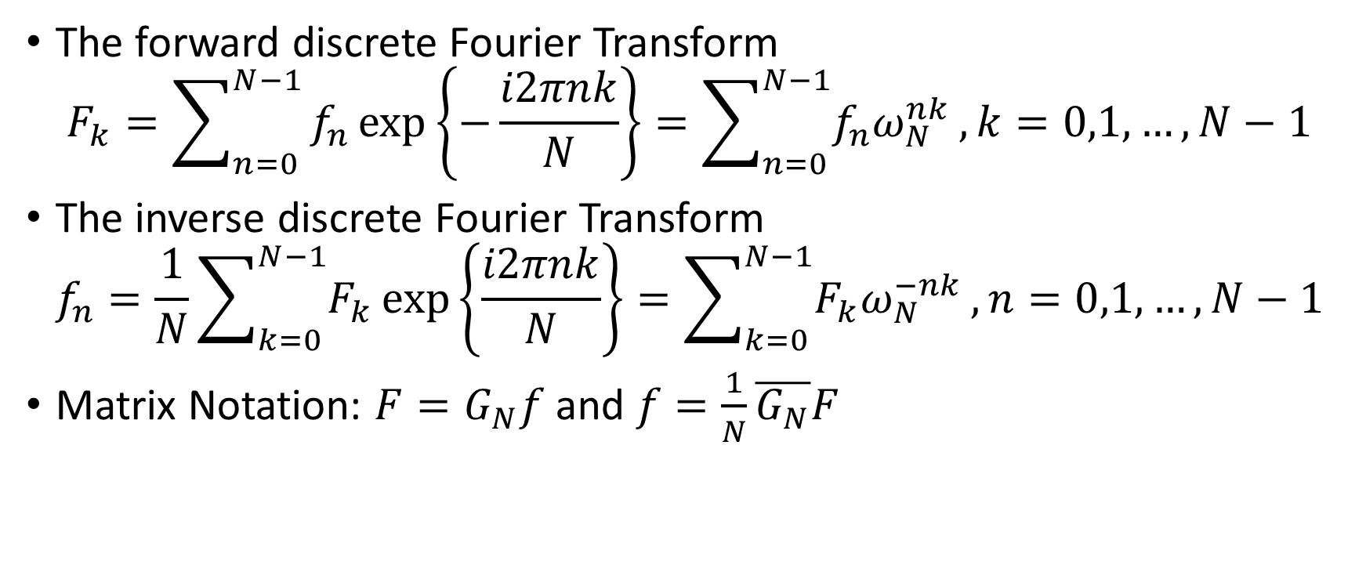
Forward and Inverse DFTs
The forward discrete Fourier Transform
$$F_{k}=\sum_{n=0}^{N−1}{f_{n}\exp\left\{−\frac{i2πnk}{N}\right\}}=\sum_{n=0}^{N−1}{f_{n}ω_{N}^{nk}},k=0,1,…,N−1$$
The inverse discrete Fourier Transform
$$f_{n}=\frac{1}{N}\sum_{k=0}^{N−1}{F_{k}}\exp\left\{\frac{i2πnk}{N}\right\}=\sum_{k=0}^{N−1}{F_{k}ω_{N}^{−nk}},n=0,1,…,N−1$$
Matrix Notation: $F=G_{N}f$ and $f=\frac{1}{N}\overline{G_{N}}F$
But, what does this have to do with convolution?

Slide 4
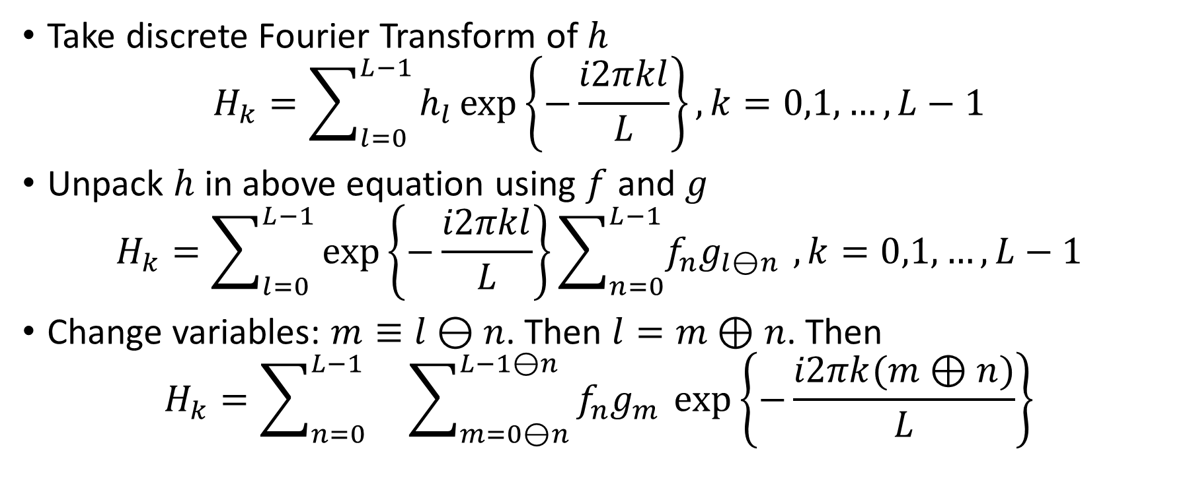
Circular Convolution and discrete Fourier Transform
Take discrete Fourier Transform of $h$
$$H_{k}=\sum_{l=0}^{L−1}{h_{l}\exp\left\{−\frac{i2πkl}{L}\right\}}, k=0,1,…,L−1$$
Unpack $h$ in above equation using $f$ and $g$
$$H_{k}=\sum_{l=0}^{L−1}{\exp\left\{−\frac{i2πkl}{L}\right\}}\sum_{n=0}^{L−1}{f_{n}g_{l⊖n }},k=0,1,…,L−1$$
Change variables: $m≡l⊖n$. Then $l=m⊕n$. Then
$$H_{k}=\sum_{n=0}^{L−1}{}\sum_{m=0⊖n}^{L−1⊖n}{f_{n}g_{m }\exp\left\{−\frac{i2πk(m⊕n)}{L}\right\}}$$

Slide 5
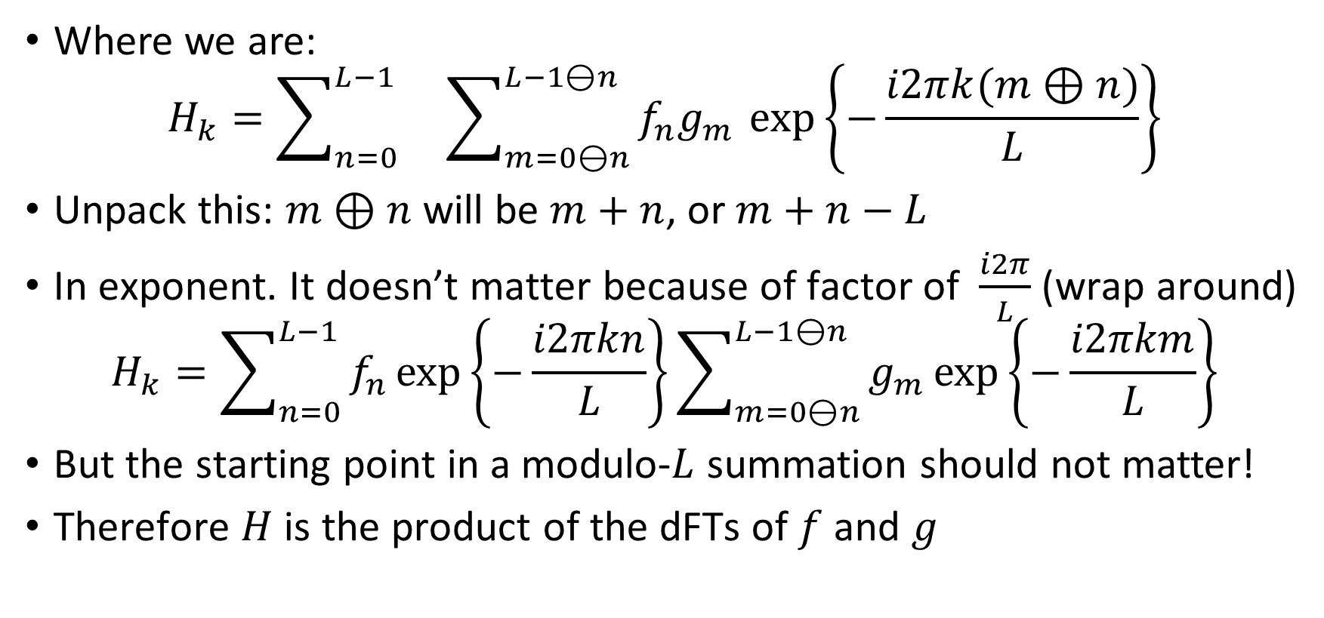
Circular Convolution (fini)
Where we are:
$$H_{k}=\sum_{n=0}^{L−1}{}\sum_{m=0⊖n}^{L−1⊖n}{f_{n}g_{m }\exp\left\{−\frac{i2πk(m⊕n)}{L}\right\}}$$
Unpack this: $m⊕n$ will be $m+n$, or $m+n−L$
In exponent. It doesn’t matter because of factor of $\frac{i2π}{L}$ (wrap around)
$$H_{k}=\sum_{n=0}^{L−1}{f_{n}\exp\left\{−\frac{i2πkn}{L}\right\}}\sum_{m=0⊖n}^{L−1⊖n}{g_{m}\exp\left\{−\frac{i2πkm}{L}\right\}}$$
But the starting point in a modulo-$L$ summation should not matter!
Therefore $H$ is the product of the dFTs of $f$ and $g$

Slide 6
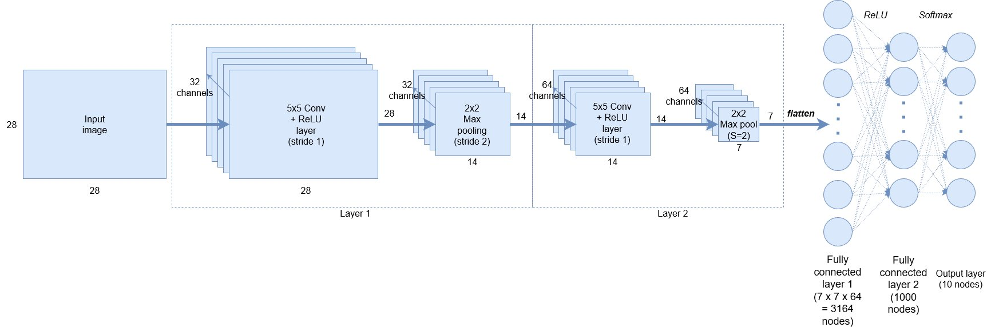
CNN Block Diagram

Slide 7
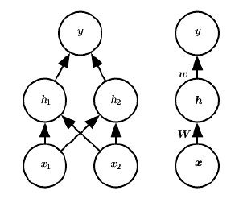


Feedforward networks
$$h_{1}={\max\left\{0,{W_{11}x}_{1}+W_{12}x_{2}+c_{1}\right\}}_{}$$
$$h_{2}=\max\left\{0,W_{21}x_{1}+W_{22}x_{2}+c_{2}\right\}$$
$$y=w_{1}h_{1}+w_{2}h_{2}+b$$
Note: $W$ and $w$ similar to text but transposed

Slide 8
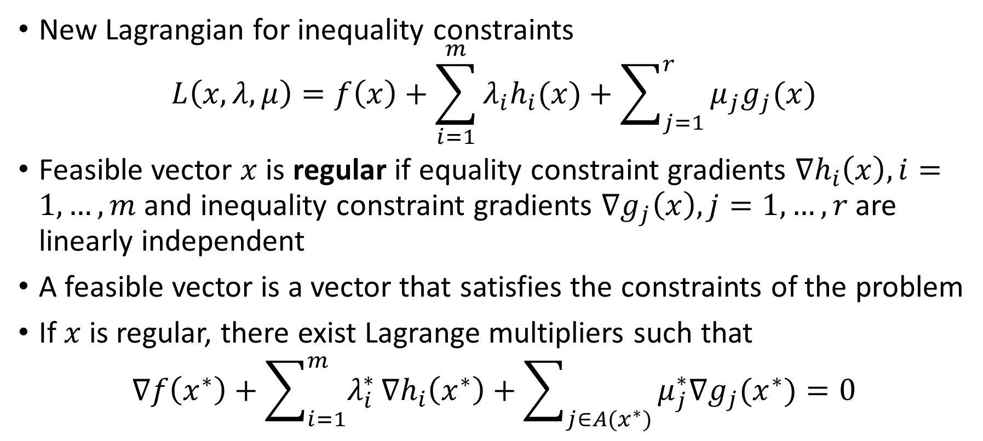
The Lagrangian
New Lagrangian for inequality constraints
$$L\left(x,λ,μ\right)=f\left(x\right)+\sum_{i=1}^{m}{λ_{i}h_{i}(x)}+\sum_{j=1}^{r}{μ_{j}g_{j}(x)}$$
Feasible vector $x$ is regular if equality constraint gradients $∇h_{i}\left(x\right),i=1,…,m$ and inequality constraint gradients $∇g_{j}\left(x\right),j=1,…,r$ are linearly independent
A feasible vector is a vector that satisfies the constraints of the problem
If $x$ is regular, there exist Lagrange multipliers such that
$$∇f\left(x^{∗}\right)+\sum_{i=1}^{m}{λ_{i}^{∗}}∇h_{i}\left(x^{∗}\right)+\sum_{j∈A(x^{∗})}{μ_{j}^{∗}∇g_{j}(x^{∗})}=0$$

Slide 9
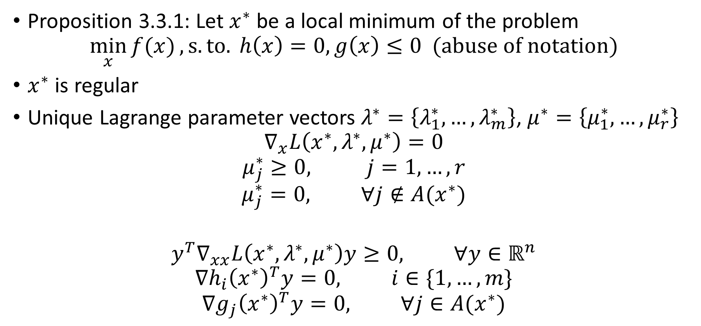
Karush-Kuhn-Tucker (KKT) necessary conditions
Proposition 3.3.1: Let $x^{∗}$ be a local minimum of the problem
$$\min_{x}{f(x)}, s.to. h\left(x\right)=0, g\left(x\right)≤0 (abuse of notation)$$
$x^{∗}$ is regular
Unique Lagrange parameter vectors $λ^{∗}=\left\{λ_{1}^{∗},…,λ_{m}^{∗}\right\}$, $μ^{∗}=\left\{μ_{1}^{∗},…,μ_{r}^{∗}\right\}$
$$∇_{x}L\left(x^{∗},λ^{∗},μ^{∗}\right)=0$$
$$μ_{j}^{∗}≥0, j=1,…,r$$
$$μ_{j}^{∗}=0, ∀j∉A(x^{∗})$$
$$y^{T}∇_{xx}L\left(x^{∗},λ^{∗},μ^{∗}\right)y≥0, ∀y∈ℝ^{n}$$
$$∇h_{i}{\left(x^{∗}\right)}^{T}y=0, i∈\{1,…,m\}$$
$$∇g_{j}{\left(x^{∗}\right)}^{T}y=0, ∀j∈A(x^{∗})$$

Slide 10
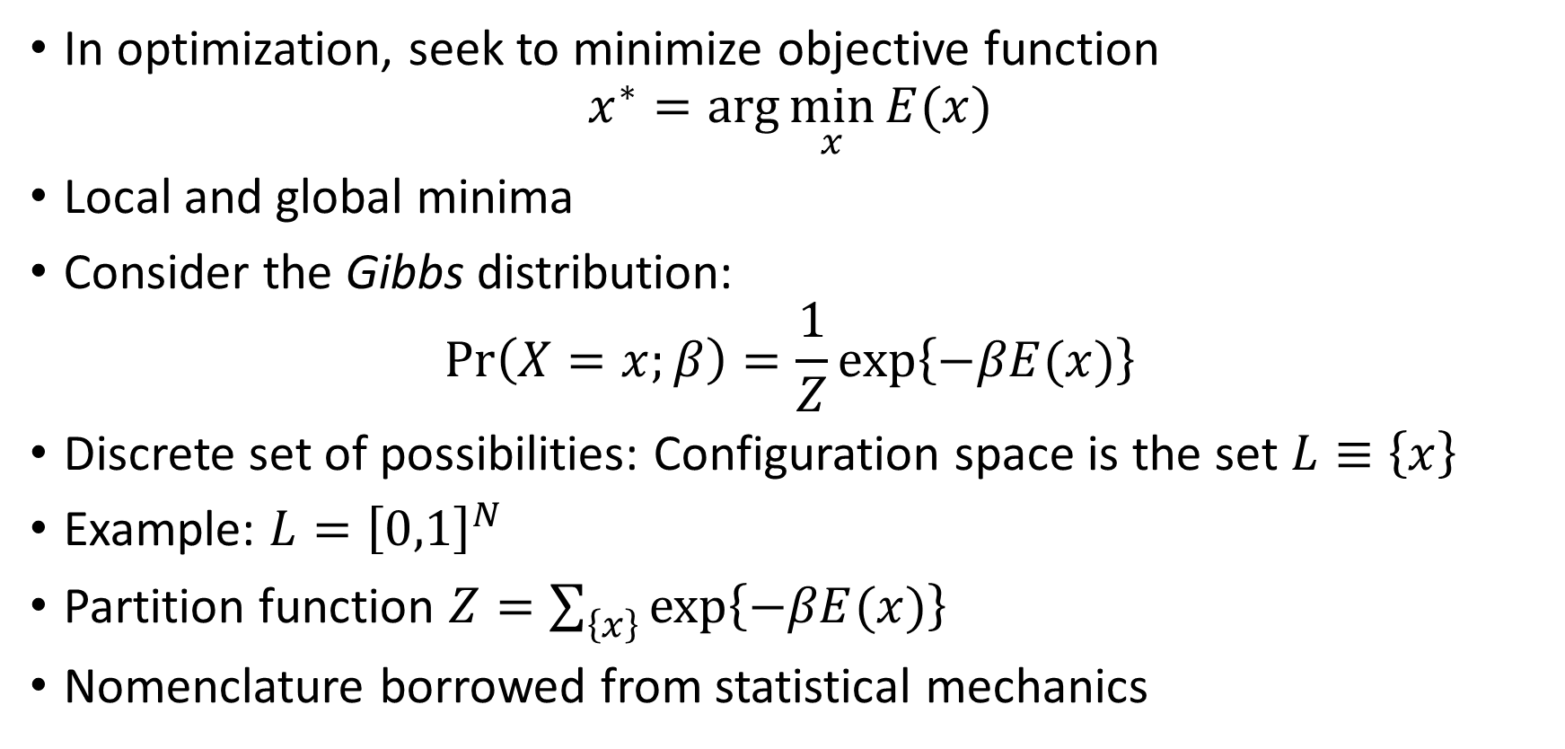
The Link Between Optimization and Statistics
In optimization, seek to minimize objective function
$$x^{∗}=\arg{\min_{x}{E(x)}}$$
Local and global minima
Consider the Gibbs distribution:
$$\operatorname{Pr}\left(X=x;β\right)=\frac{1}{Z}\exp\left\{−βE(x)\right\}$$
Discrete set of possibilities: Configuration space is the set $L≡\left\{x\right\}$
Example: $L={\left[0,1\right]}^{N}$
Partition function $Z=\sum_{\left\{x\right\}}{\exp\left\{−βE(x)\right\}}$
Nomenclature borrowed from statistical mechanics

Slide 11
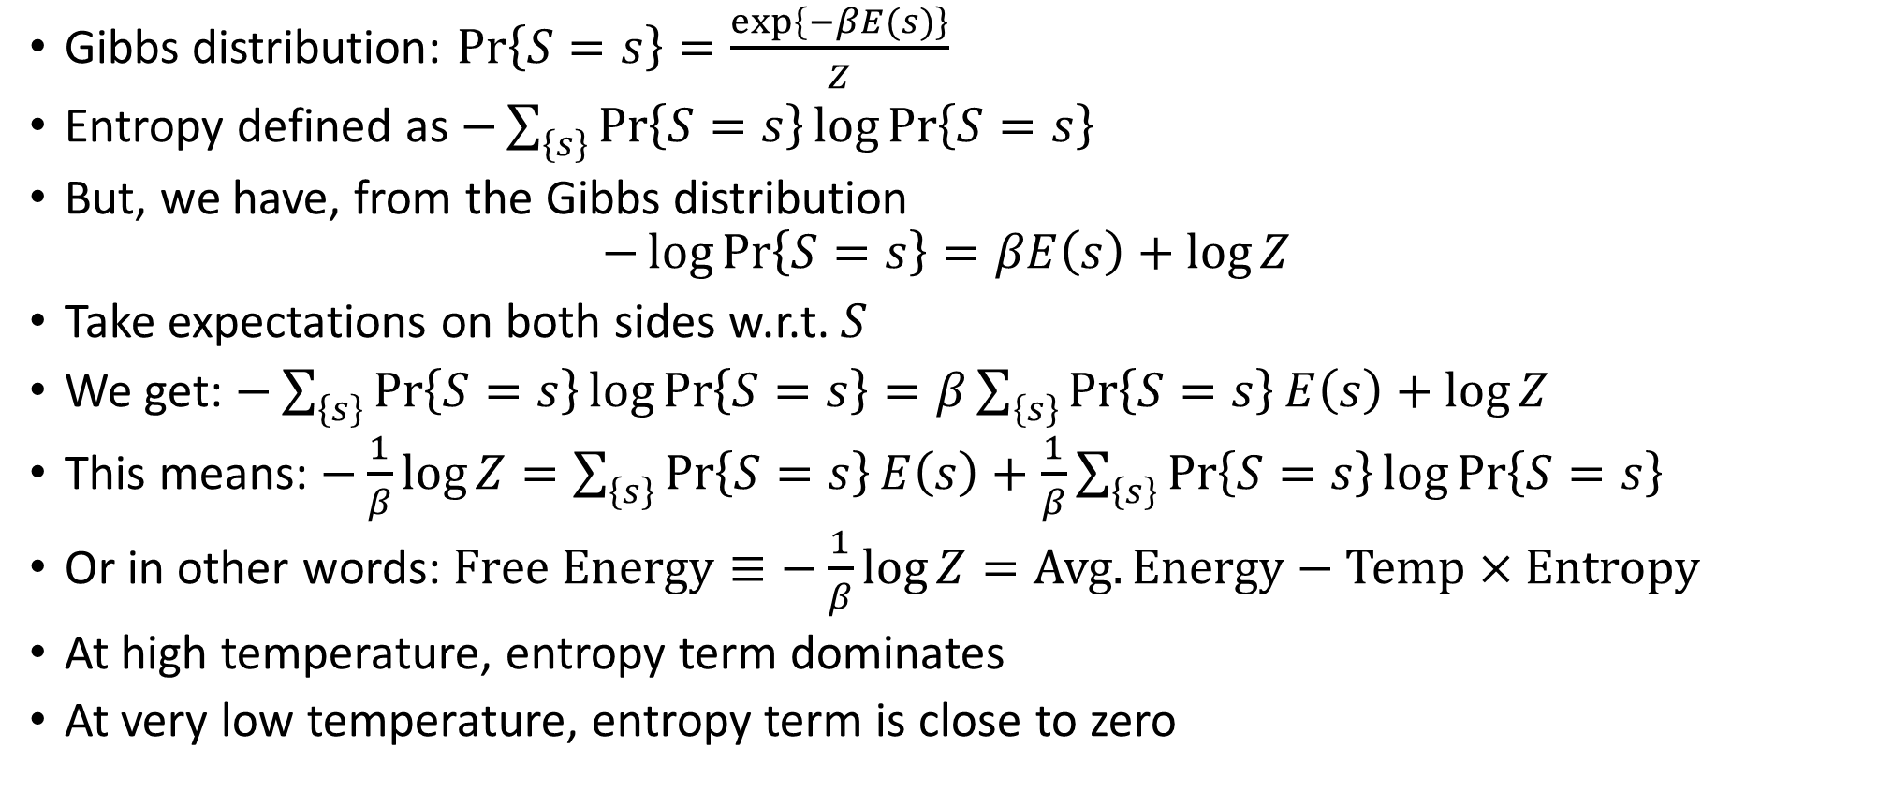
Entropy and Free Energy
Gibbs distribution: $\operatorname{Pr}\left\{S=s\right\}=\frac{\exp\left\{−βE(s)\right\}}{Z}$
Entropy defined as $−\sum_{\left\{s\right\}}{\operatorname{Pr}\left\{S=s\right\}}\log{\operatorname{Pr}\left\{S=s\right\}}$
But, we have, from the Gibbs distribution
$$−\log{\operatorname{Pr}\left\{S=s\right\}}=βE\left(s\right)+\log{Z}$$
Take expectations on both sides w.r.t. $S$
We get: $−\sum_{\left\{s\right\}}{\operatorname{Pr}\left\{S=s\right\}}\log{\operatorname{Pr}\left\{S=s\right\}}=β\sum_{\left\{s\right\}}{\operatorname{Pr}\left\{S=s\right\}}E\left(s\right)+\log{Z}$
This means: $−\frac{1}{β}\log{Z}=\sum_{\left\{s\right\}}{\operatorname{Pr}\left\{S=s\right\}}E\left(s\right)+\frac{1}{β}\sum_{\left\{s\right\}}{\operatorname{Pr}\left\{S=s\right\}}\log{\operatorname{Pr}\left\{S=s\right\}}$
Or in other words: $Free Energy≡−\frac{1}{β}\log{Z}=Avg. Energy−Temp×Entropy$
At high temperature, entropy term dominates
At very low temperature, entropy term is close to zero

Slide 12
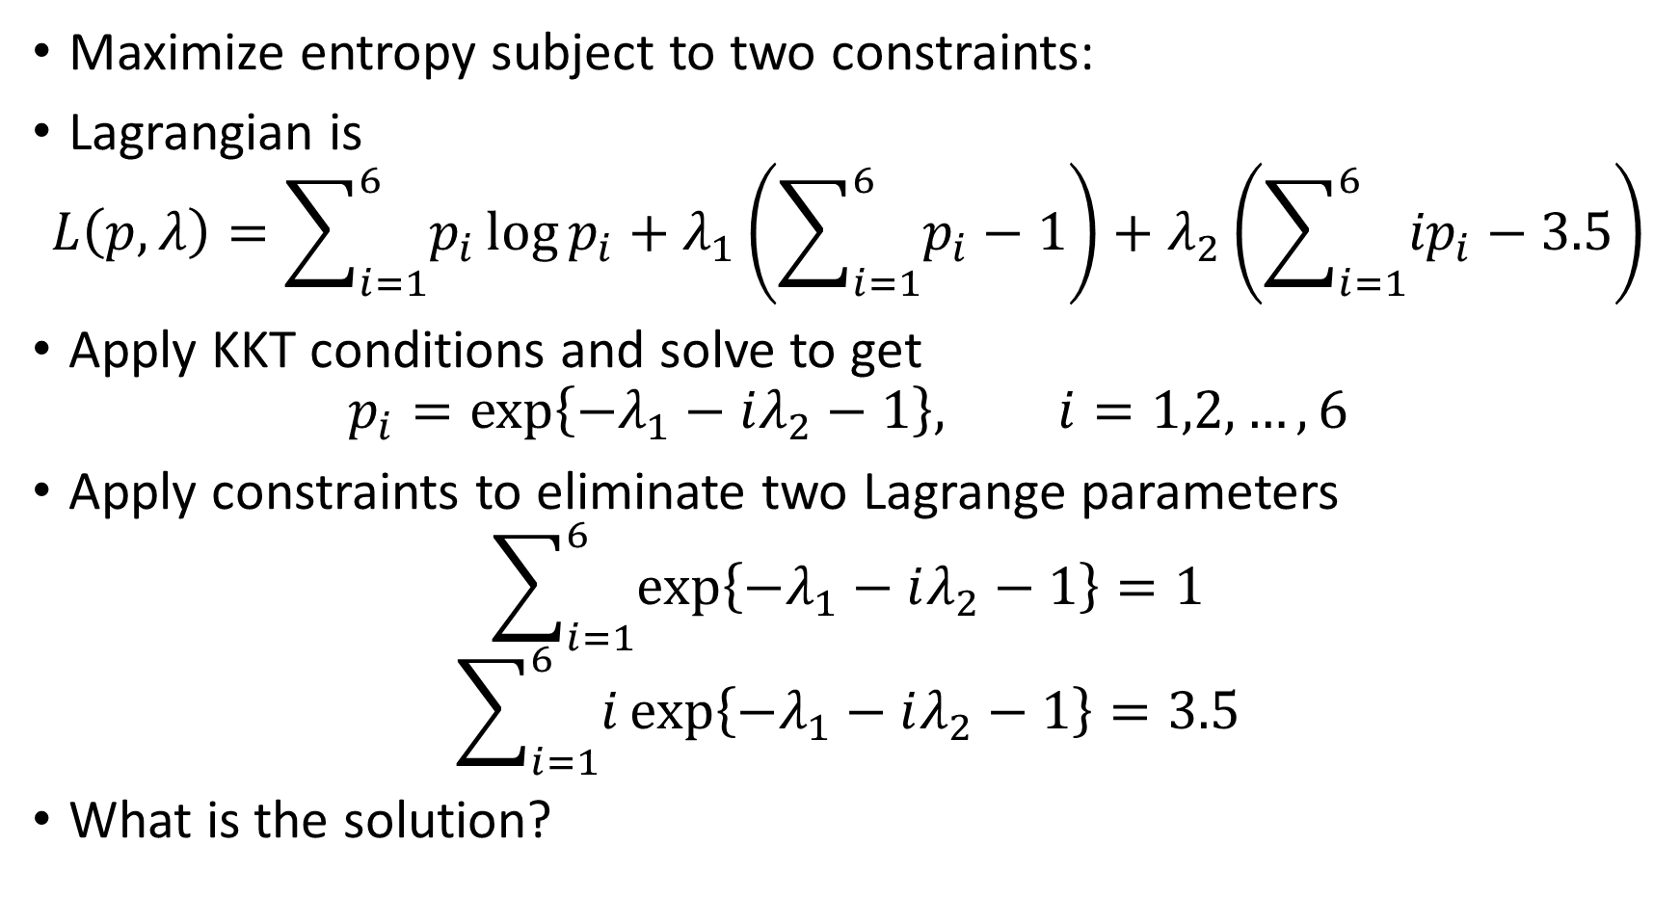
Lagrangian for Maximum Entropy
Maximize entropy subject to two constraints:
Lagrangian is
$$L\left(p,λ\right)=\sum_{i=1}^{6}{p_{i}}\log{p_{i}}+λ_{1}\left(\sum_{i=1}^{6}{p_{i}}−1\right)+λ_{2}\left(\sum_{i=1}^{6}{{ip}_{i}}−3.5\right)$$
Apply KKT conditions and solve to get
$$p_{i}=\exp\left\{−λ_{1}−iλ_{2}−1\right\}, i=1,2,…,6$$
Apply constraints to eliminate two Lagrange parameters
$$\sum_{i=1}^{6}{\exp\left\{−λ_{1}−iλ_{2}−1\right\}}=1$$
$$\sum_{i=1}^{6}{i\exp\left\{−λ_{1}−iλ_{2}−1\right\}}=3.5$$
What is the solution?

Slide 13
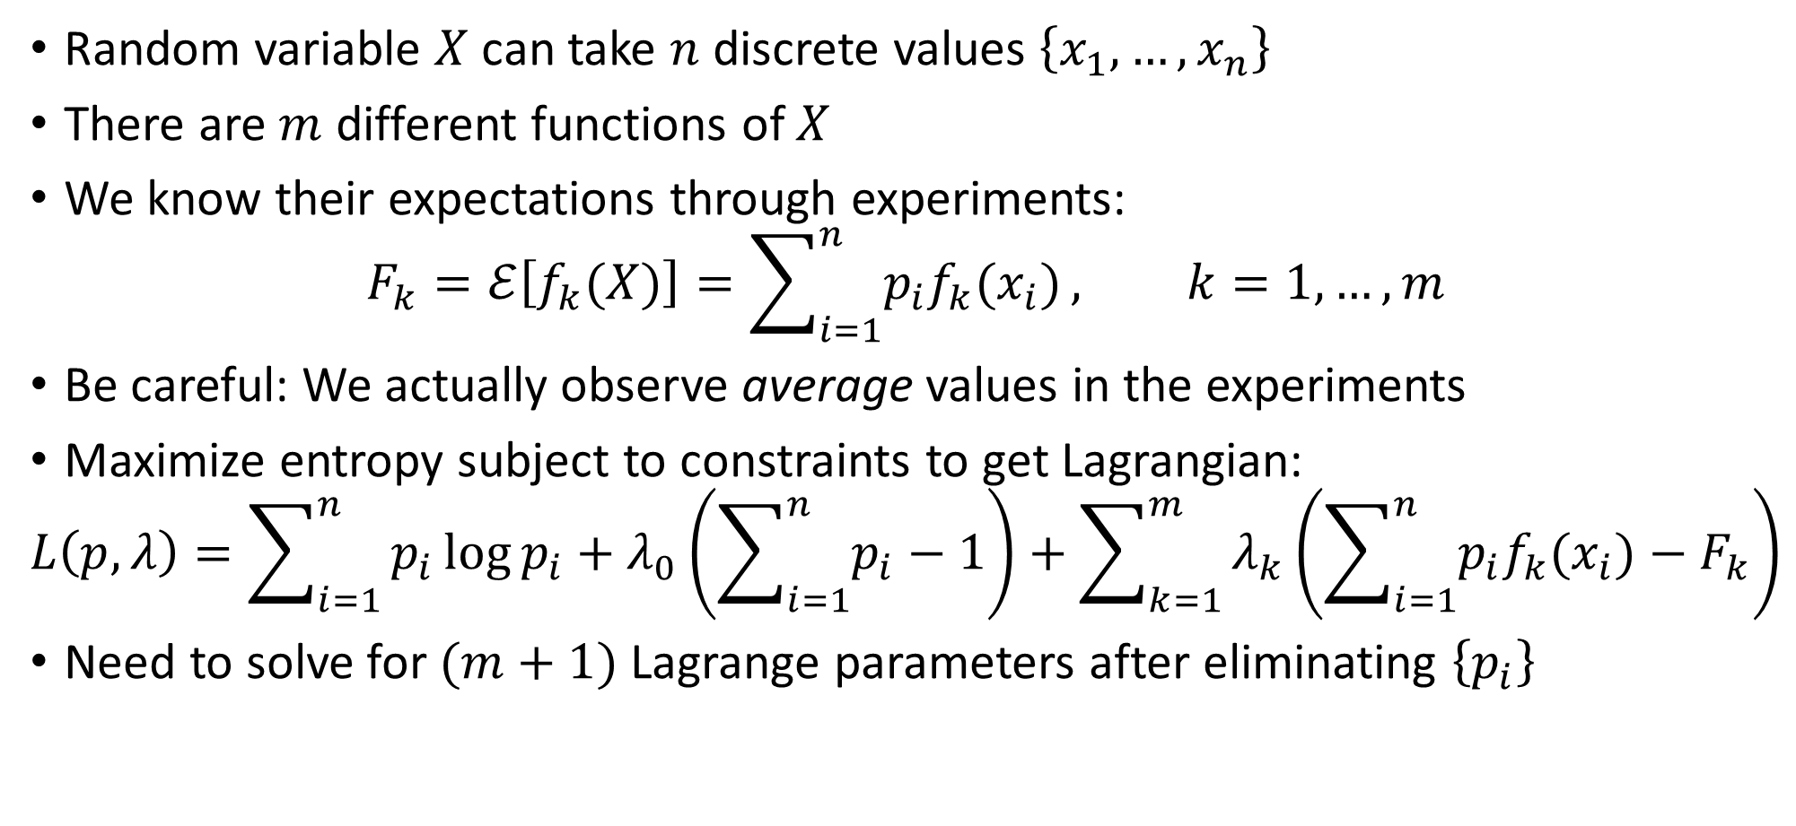
Generalization
Random variable $X$ can take $n$ discrete values $\left\{x_{1},…,x_{n}\right\}$
There are $m$ different functions of $X$
We know their expectations through experiments:
$$F_{k}=ℰ\left[f_{k}(X)\right]=\sum_{i=1}^{n}{p_{i}f_{k}(x_{i})}, k=1,…,m$$
Be careful: We actually observe average values in the experiments
Maximize entropy subject to constraints to get Lagrangian:
$$L\left(p,λ\right)=\sum_{i=1}^{n}{p_{i}\log{p_{i}}+λ_{0}\left(\sum_{i=1}^{n}{p_{i}}−1\right)+\sum_{k=1}^{m}{λ_{k}\left(\sum_{i=1}^{n}{p_{i}f_{k}(x_{i})}−F_{k}\right)}}$$
Need to solve for $(m+1)$ Lagrange parameters after eliminating $\left\{p_{i}\right\}$

Slide 14
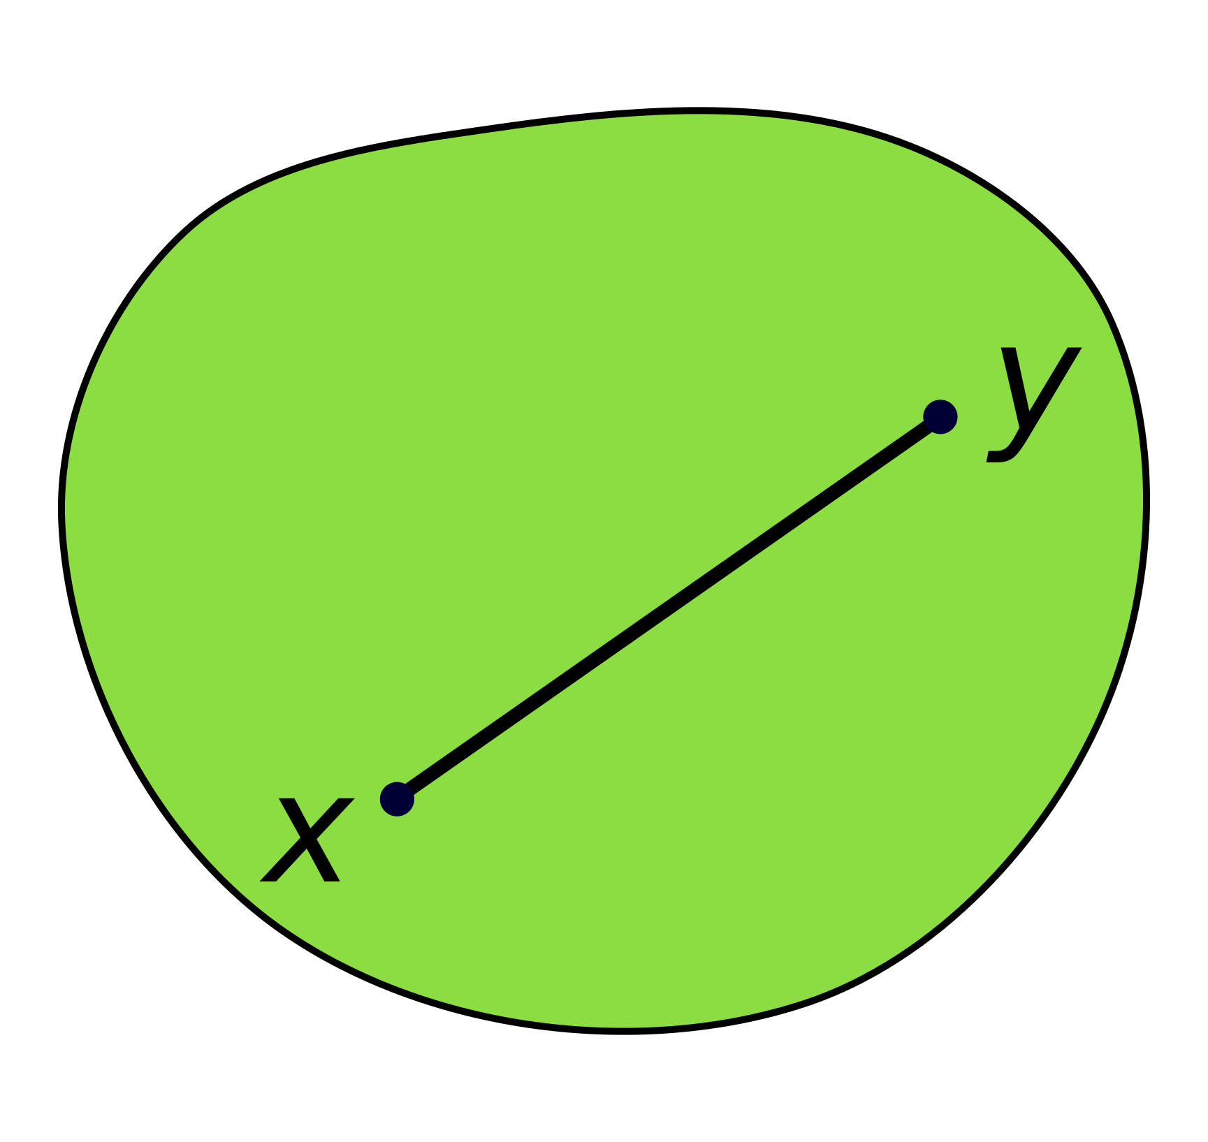
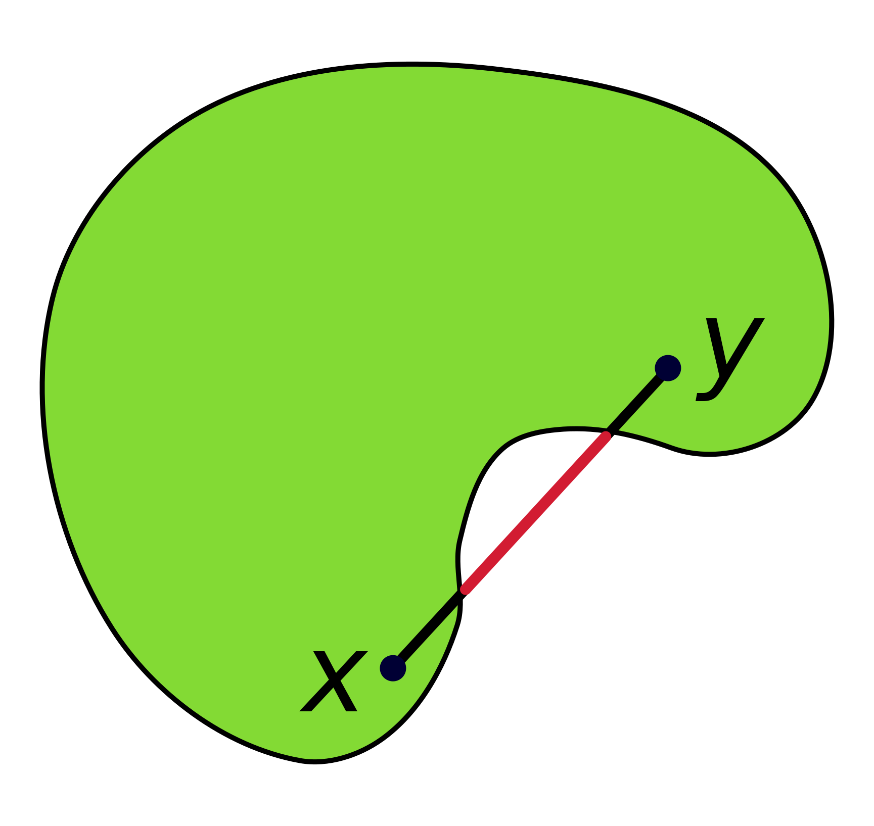
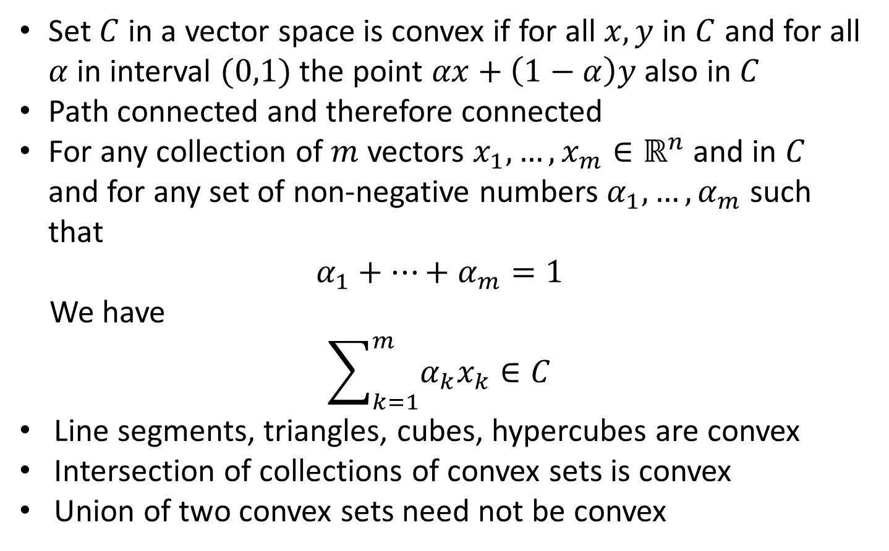
Convexity
Convex Set
Set $C$ in a vector space is convex if for all $x,y$ in $C$ and for all $α$ in interval $(0,1)$ the point $αx+\left(1−α\right)y$ also in $C$
Path connected and therefore connected
For any collection of $m$ vectors $x_{1},…,x_{m}∈ℝ^{n}$ and in $C$ and for any set of non-negative numbers $α_{1},…,α_{m}$ such that
$$α_{1}+…+α_{m}=1$$
We have
$$\sum_{k=1}^{m}{α_{k}x_{k}}∈C$$
Line segments, triangles, cubes, hypercubes are convex
Intersection of collections of convex sets is convex
Union of two convex sets need not be convex
Non-convex Set
Source: CheCheDaWaff (Wikipedia)

Slide 15
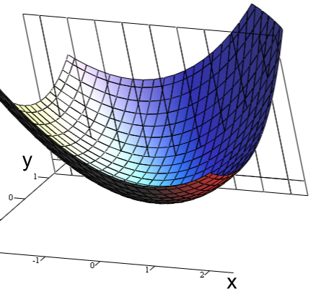
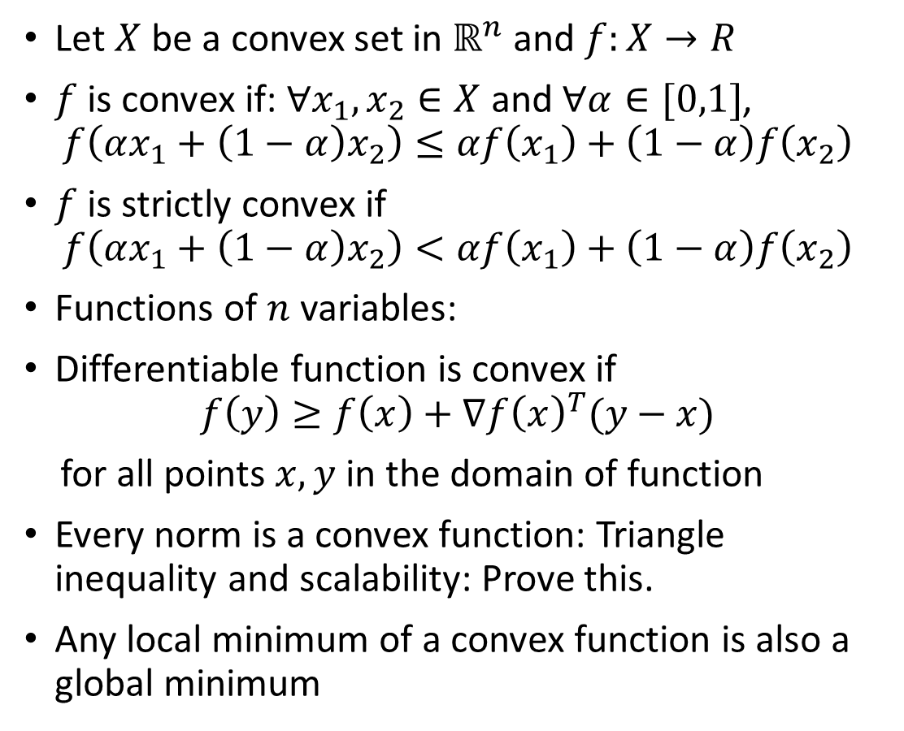
Convex Functions
Let $X$ be a convex set in $ℝ^{n}$ and $f:X→R$
$f$ is convex if: $∀x_{1},x_{2}∈X$ and $∀α∈[0,1]$,
$$f\left(αx_{1}+\left(1−α\right)x_{2}\right)≤αf\left(x_{1}\right)+\left(1−α\right)f\left(x_{2}\right)$$
$f$ is strictly convex if
$$f\left(αx_{1}+\left(1−α\right)x_{2}\right)<αf\left(x_{1}\right)+\left(1−α\right)f\left(x_{2}\right)$$
Functions of $n$ variables:
Differentiable function is convex if
$$f\left(y\right)≥f\left(x\right)+∇f{\left(x\right)}^{T}(y−x)$$
for all points $x,y$ in the domain of function
Every norm is a convex function: Triangle inequality and scalability: Prove this.
Any local minimum of a convex function is also a global minimum
Source: Indeed123 (Wikipedia)

Slide 16
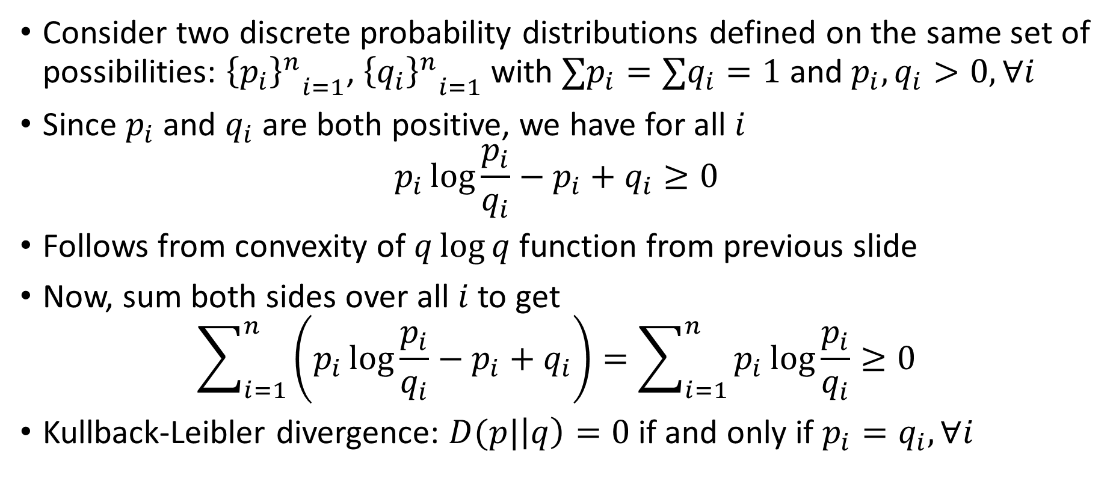
The Kullback-Leibler (KL) divergence
Consider two discrete probability distributions defined on the same set of possibilities: ${{\left\{p_{i}\right\}}^{n}}_{i=1}$, ${{\left\{q_{i}\right\}}^{n}}_{i=1}$ with $∑p_{i}=∑q_{i}=1$ and $p_{i},q_{i}>0,∀i$
Since $p_{i}$ and $q_{i}$ are both positive, we have for all $i$
$$p_{i}\log{\frac{p_{i}}{q_{i}}}−p_{i}+q_{i}≥0$$
Follows from convexity of $q\log{q}$ function from previous slide
Now, sum both sides over all $i$ to get
$$\sum_{i=1}^{n}{\left(p_{i}\log{\frac{p_{i}}{q_{i}}}−p_{i}+q_{i}\right)}=\sum_{i=1}^{n}{p_{i}\log{\frac{p_{i}}{q_{i}}}}≥0$$
Kullback-Leibler divergence: $D(p|\left|q\right)=0$ if and only if $p_{i}=q_{i},∀i$

Slide 17
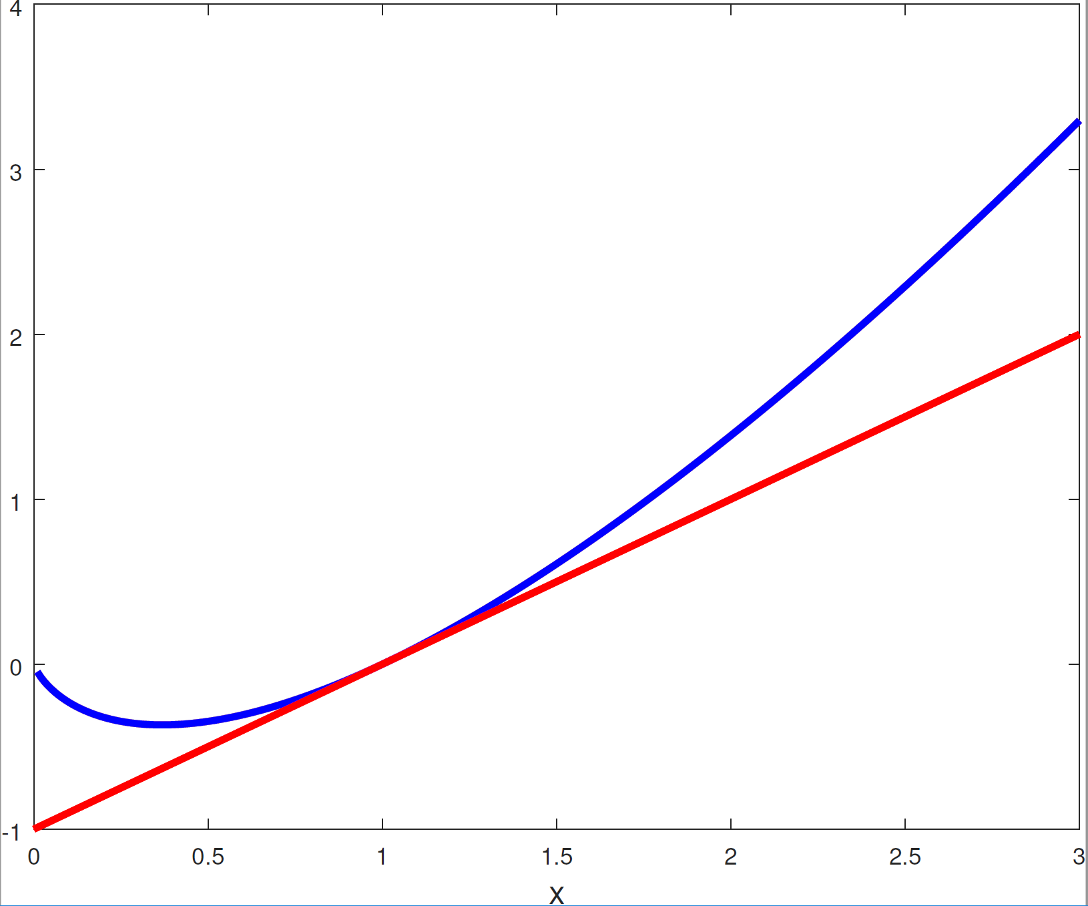
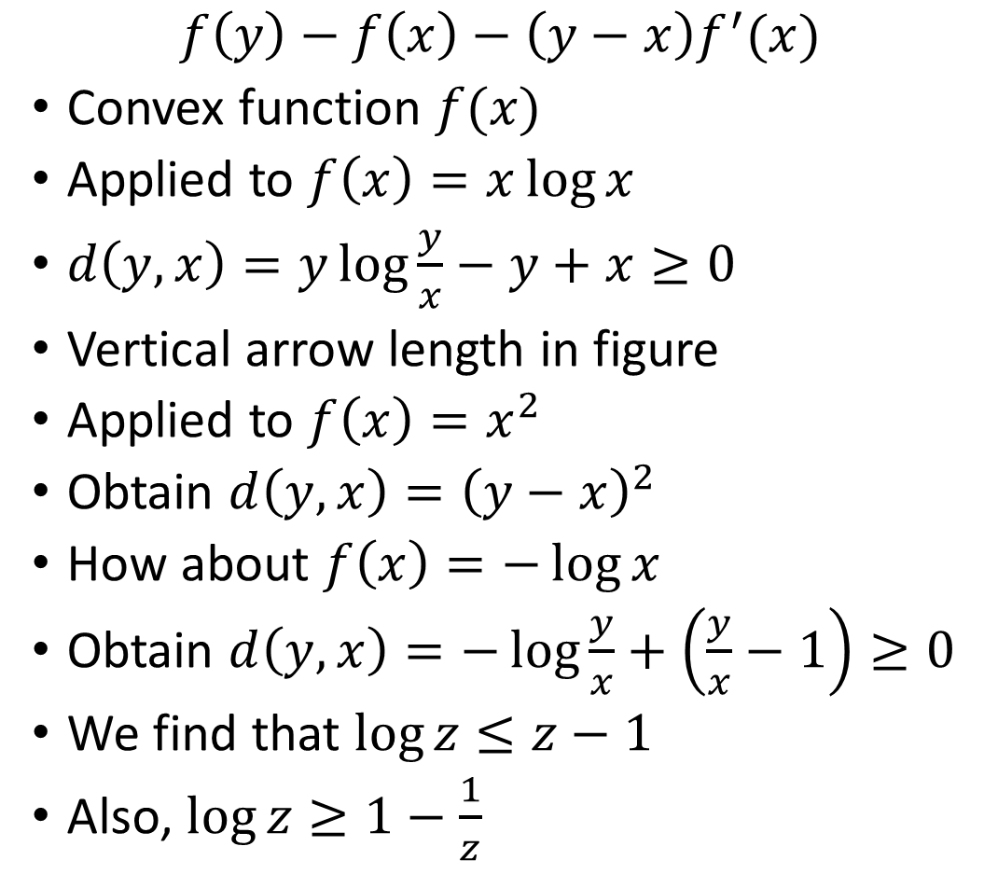
The Bregman Divergence
$$f\left(y\right)−f\left(x\right)−\left(y−x\right)f^{′}(x)$$
Convex function $f(x)$
Applied to $f\left(x\right)=x\log{x}$
$d\left(y,x\right)=y\log{\frac{y}{x}}−y+x≥0$
Vertical arrow length in figure
Applied to $f\left(x\right)=x^{2}$
Obtain $d\left(y,x\right)={\left(y−x\right)}^{2}$
How about $f\left(x\right)=−\log{x}$
Obtain $d\left(y,x\right)=−\log{\frac{y}{x}}+\left(\frac{y}{x}−1\right)≥0$
We find that $\log{z}≤z−1$
Also, $\log{z}≥1−\frac{1}{z}$

Slide 18
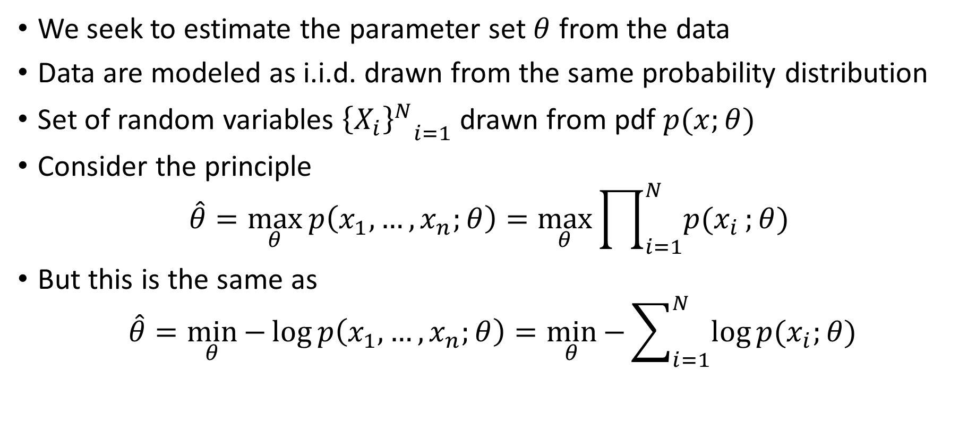
The Maximum Likelihood Principle
We seek to estimate the parameter set $θ$ from the data
Data are modeled as i.i.d. drawn from the same probability distribution
Set of random variables ${{\left\{X_{i}\right\}}^{N}}_{i=1}$ drawn from pdf $p(x;θ)$
Consider the principle
$$\hat{θ}=\max_{θ}{p\left(x_{1},…,x_{n};θ\right)}=\max_{θ}{\prod_{i=1}^{N}{p(x_{i}};θ) }$$
But this is the same as
$$\hat{θ}=\min_{θ}{−\log{p\left(x_{1},…,x_{n};θ\right)}}=\min_{θ}{−\sum_{i=1}^{N}{\log{p(x_{i};θ)}}}$$

Slide 19
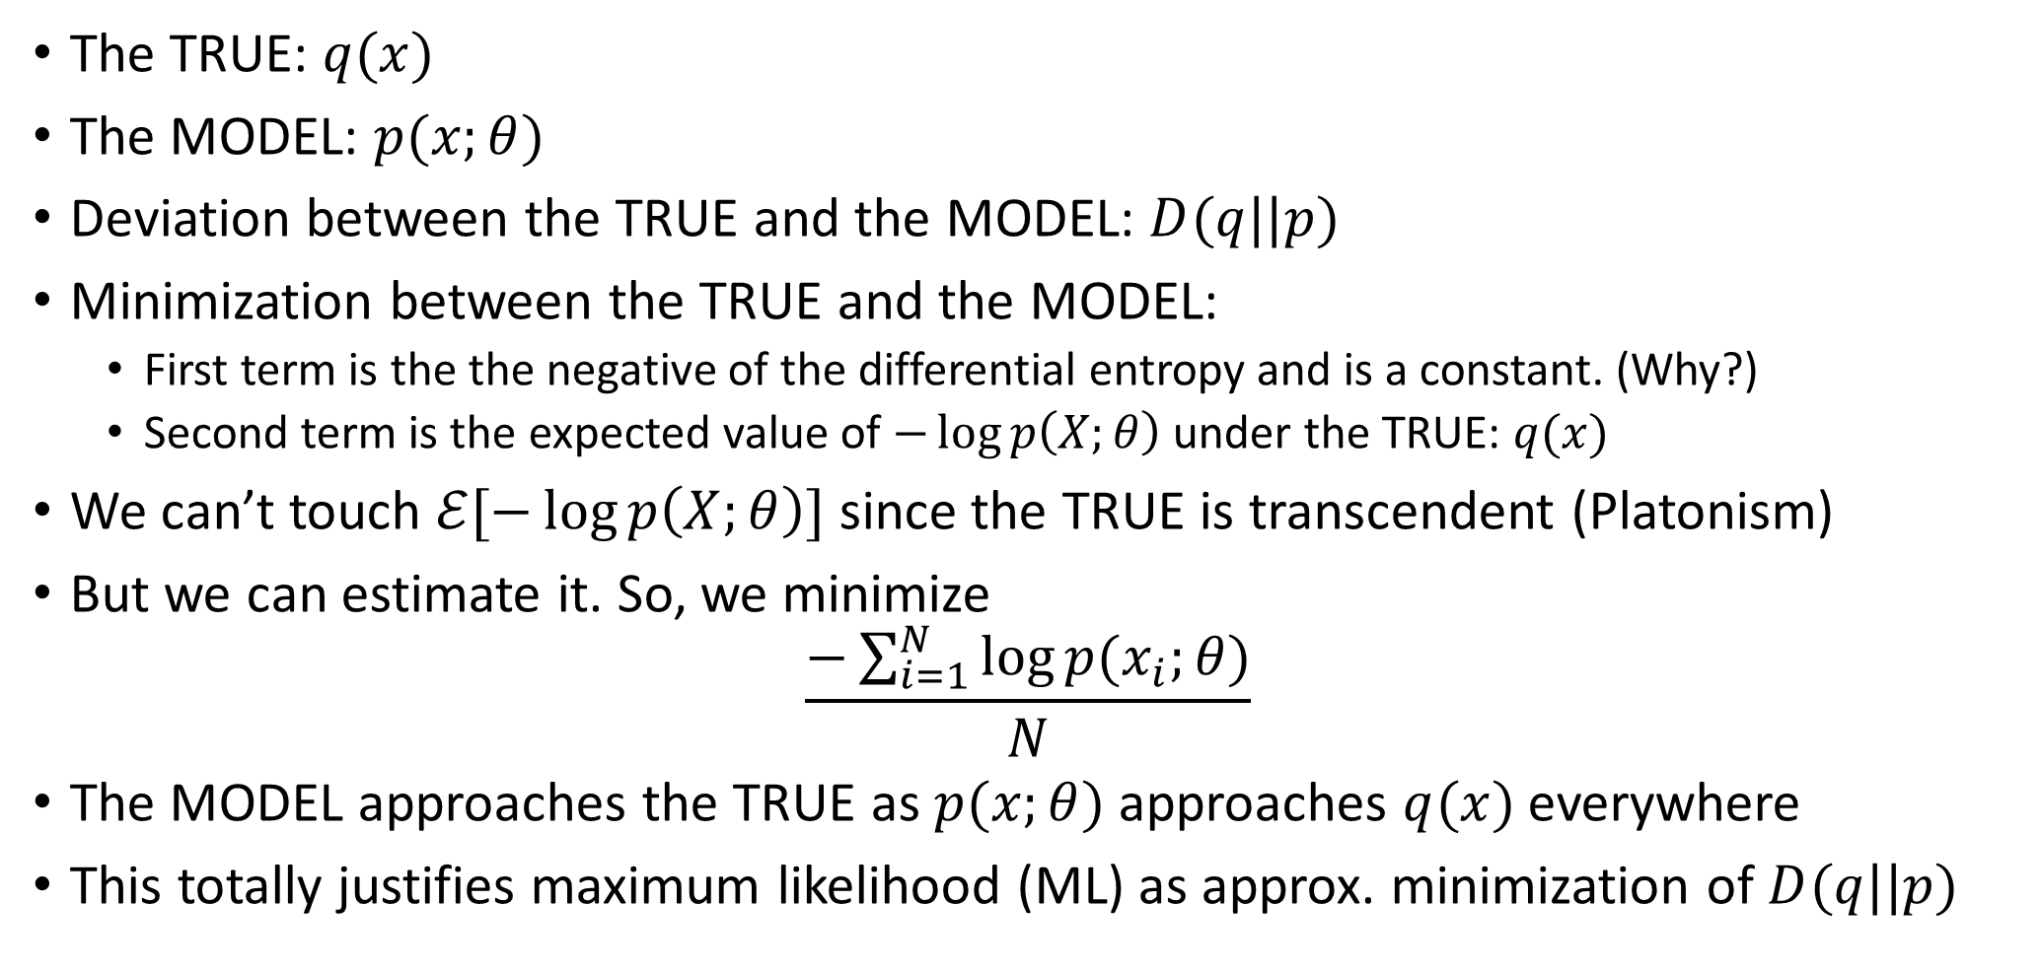
Justification of the principle
The TRUE: $q(x)$
The MODEL: $p(x;θ)$
Deviation between the TRUE and the MODEL: $D(q||p)$
Minimization between the TRUE and the MODEL:
First term is the the negative of the differential entropy and is a constant. (Why?)
Second term is the expected value of $−\log{p\left(X;θ\right)}$ under the TRUE: $q(x)$
We can’t touch $ℰ[−\log{p\left(X;θ\right)}]$ since the TRUE is transcendent (Platonism)
But we can estimate it. So, we minimize
$$\frac{−\sum_{i=1}^{N}{\log{p(x_{i};θ)}}}{N}$$
The MODEL approaches the TRUE as $p(x;θ)$ approaches $q(x)$ everywhere
This totally justifies maximum likelihood (ML) as approx. minimization of $D(q||p)$

Slide 20
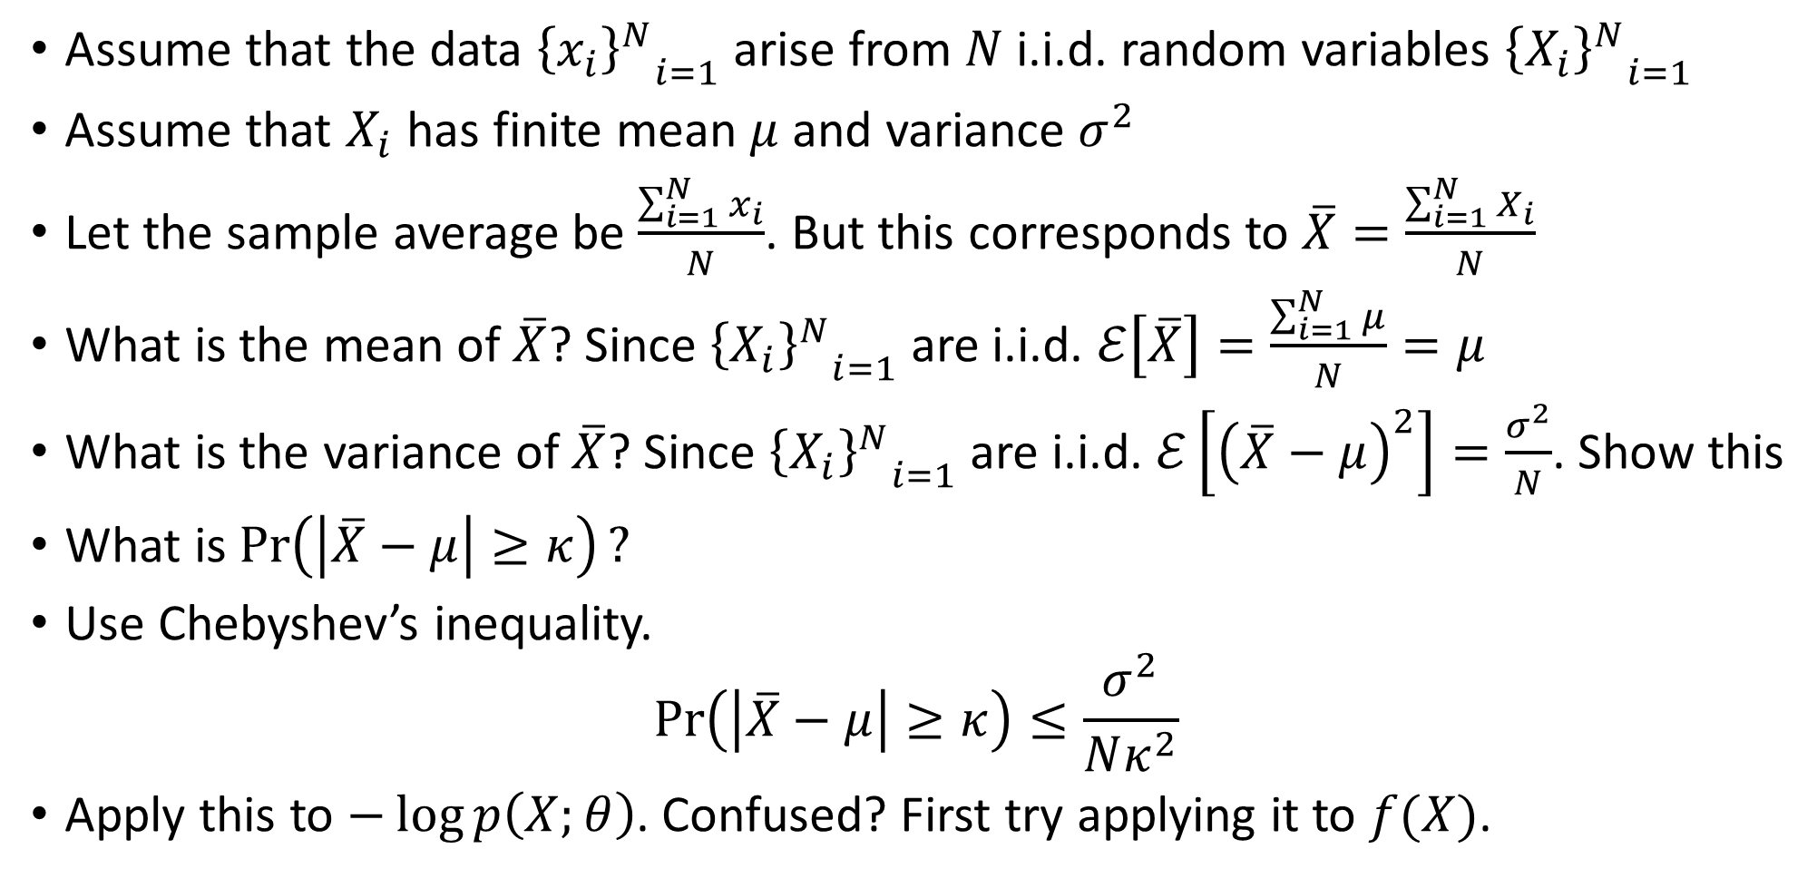
The Weak Law Of Large Numbers
Assume that the data ${{\left\{x_{i}\right\}}^{N}}_{i=1}$ arise from $N$ i.i.d. random variables ${{\left\{X_{i}\right\}}^{N}}_{i=1}$
Assume that $X_{i}$ has finite mean $μ$ and variance $σ^{2}$
Let the sample average be $\frac{\sum_{i=1}^{N}{x_{i}}}{N}$. But this corresponds to $\overline{X}=\frac{\sum_{i=1}^{N}{X_{i}}}{N}$
What is the mean of$\overline{X}$? Since ${{\left\{X_{i}\right\}}^{N}}_{i=1}$ are i.i.d. $ℰ\left[\overline{X}\right]=\frac{\sum_{i=1}^{N}{μ}}{N}=μ$
What is the variance of $\overline{X}$? Since ${{\left\{X_{i}\right\}}^{N}}_{i=1}$ are i.i.d. $ℰ\left[{\left(\overline{X}−μ\right)}^{2}\right]=\frac{σ^{2}}{N}$. Show this
What is $\operatorname{Pr}\left(\left|\overline{X}−μ\right|≥κ\right)?$
Use Chebyshev’s inequality.
$$\operatorname{Pr}\left(\left|\overline{X}−μ\right|≥κ\right)≤\frac{σ^{2}}{Nκ^{2}}$$
Apply this to $−\log{p\left(X;θ\right)}$. Confused? First try applying it to $f(X)$.

Slide 21
Preparation Hints
First commit to grokking broad outline
Separate into topics: Convolution, CNN, Constrained Optimization, Gibbs distributions, Maximum Entropy, Convexity and Divergences, Maximum Likelihood and Weak Law of Large Numbers
In each topic, get the principle
Realize which topics are fuzzy
Work out problems, examples in each fuzzy topic and revisit homework problems
Good Luck!

